Slide 1


FINAL REVIEW
DEEP LEARNING-BASED SAFETY OUTFIT DETECTION SYSTEM FOR INDUSTRIAL ZONES
PRESENTED BY:
Pharos Sophy Samuel T J

Slide 2

Introduction
Problem Statement
Agenda
Research Objective
Proposed System
Result
Conclusion
Future work
References

Slide 3
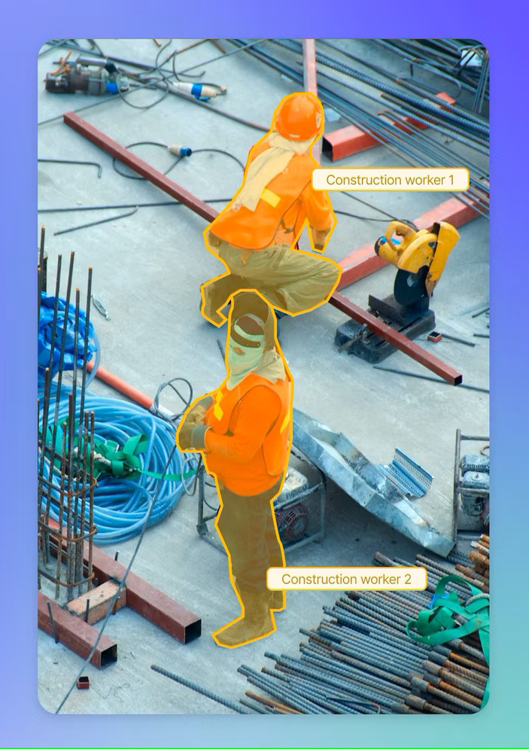
INTRODUCTON
A) Statement of Problem/Challenges:
In Industrial environments, adhering to safety protocols, particularly wearing appropriate safety outfits, is crucial to prevent accidents and ensure the well-being of employees. However, a persistent issue in many industries is the non-compliance of employees with these safety regulations. A significant challenge faced in this regard is the lack of adherence to the mandatory wearing of safety outfits, including safety helmets, vest, masks, gloves, and boots, in designated areas. This non-compliance not only endangers the employees themselves but also poses a risk to their colleagues and the overall safety of the industrial environment.

Slide 4
Background, Context, and Significance of Study
Industrial safety is a paramount concern, with various regulations and guidelines in place to protect workers. However, manual monitoring of compliance is labor-intensive and prone to human error, leading to gaps in safety enforcement. In recent years, technological advancements, especially in artificial intelligence and deep learning, have opened new avenues for enhancing workplace safety.
This study proposes the implementation of a deep learning-based system for the detection of safety outfit non-compliance in industrial settings. Such a system can autonomously monitor compliance, thereby reducing the reliance on manual checks. By utilizing facial recognition, the system can identify individuals and record specific instances of non-compliance. This capability is not only essential for immediate corrective action but also for long-term safety compliance analysis and policy development.
The significance of this study lies in its potential to revolutionize safety protocol enforcement in industrial environments. By ensuring higher compliance rates, the system can significantly reduce the risk of accidents and injuries, leading to a safer workplace.

Slide 5

PROBLEM STATEMENT:
Back to Agenda
In industrial environments, safety is of utmost importance. A critical aspect of ensuring worker safety is the mandatory wearing of specific safety outfits, including helmets, vest and mask, in designated areas. However, a significant problem that industries face is the non-compliance of employees with these safety regulations. This non-compliance leads to an increased risk of accidents and injuries, posing a serious threat to individual safety and overall workplace security.
The challenge is twofold. Firstly, there is the difficulty in continuously monitoring and enforcing the compliance of safety regulations across large and complex industrial zones. Manual monitoring is not only labor-intensive but also prone to human error, making it an unreliable method for ensuring safety compliance. Secondly, there is an absence of a systematic approach to record and analyze instances of non-compliance, which is essential for understanding patterns, identifying frequent violators, and developing targeted safety interventions.

Slide 6
RESEARCH OBJECTIVE:
Back to Agenda
The primary objective of this research is to design, develop, and validate a deep learning-based system for detecting safety outfit in industrial zones. This system aims to enhance workplace safety by ensuring adherence to safety gear regulations, thereby reducing the risk of accidents and promoting a culture of safety. The specific goals of this research are:
Develop a Deep Learning Model: To create an advanced deep learning model capable of accurately detecting and classifying safety outfits, such as helmets, vest and mask. This model should function effectively under various industrial conditions, including different lighting, angles, and distances.

Slide 7
RESEARCH OBJECTIVE:
Back to Agenda
Implement Reliable Facial Recognition: To integrate a robust facial recognition system that can identify individuals in diverse and challenging industrial environments, ensuring accurate association of safety outfit compliance with specific employees.
Ensure Data Privacy and Ethical Compliance: To address privacy and ethical concerns by developing a system that complies with data protection laws. This involves secure handling of personal data and ensuring transparency in data usage.
Achieve Real-Time Processing and High Reliability: To ensure the system processes data in real time and maintains high reliability and accuracy in detecting non-compliance, which is crucial for immediate corrective action.
Integrate with Existing Industrial Systems: To design the system for easy integration with existing safety protocols and IT infrastructure in industries, ensuring compatibility and minimal disruption.

Slide 8
LITERATURE REVIEW:
Title: Fast Personal Protective Equipment Detection for Real Construction Sites Using Deep Learning Approaches
Authors: Arjun Thirunavukarasu
Description:
The existing deep learning-based Personal Protective Equipment (PPE) detectors can only detect limited types of PPE and their performance needs to be improved, particularly for their deployment on real construction sites. This paper introduces an approach to train and evaluate eight deep learning detectors, for real application purposes, based on You Only Look Once (YOLO) architectures for six classes, including helmets with four colours, person, and vest. Meanwhile, a dedicated high-quality dataset, CHV, consisting of 1330 images, is constructed by considering real construction site background, different gestures, varied angles and distances, and multi PPE classes. The comparison result among the eight models shows that YOLO v5x has the best mAP (86.55%), and YOLO v5s has the fastest speed (52 FPS) on GPU. The detection accuracy of helmet classes on blurred faces decreases by 7%, while there is no effect on other person and vest classes. And the proposed detectors trained on the CHV dataset have a superior performance compared to other deep learning approaches on the same datasets. The novel multiclass CHV dataset is open for public use.

Slide 9
Title Deep learning for site safety: Real-time detection of personal protective equipment
Authors: Nipun D. Nath
Description:
A major obstacle faced when developing convolutional neural networks (CNNs) for medical imaging is the acquisition of training labels: most current approaches rely on manually prescribed labels from physicians, which are time consuming and labor intensive to attain. Clinical biomarkers, often measured alongside medical images and used in diagnostic workup, may provide a rich set of data that can be collected retrospectively and utilized to train diagnostic models. In this work, we focused on the blood serum biomarkers BNP and BNPP, indicative of acute heart failure (HF) and cardiogenic pulmonary edema, paired with the chest X-ray imaging modality. We investigated the potential for inferring BNP and BNPP from chest radiographs. For this purpose, a CNN was trained using \textcolor{black}{27748} radiographs to automatically infer BNP and BNPP, and achieved strong performance (AUC=0.90, \textcolor{black}{SEN=0.88}, \textcolor{black}{SPEC=0.81}, r=0.79). Since radiographic features of pulmonary edema may not be visible on low resolution images, we also assessed the impact of image resolution on model learning and performance, comparing CNNs trained at five image sizes (64×64 to 1024×1024). With comparable AUC values obtained at different resolutions, our experiments using three activation mapping techniques (saliency, Grad-CAM, XRAI) revealed considerable in-lung attention growth with increased resolution. The highest resolution models focus attention on the lungs, necessary for radiographic diagnosis of pulmonary edema. Our results emphasize the need to utilize radiographs of near-native resolution for optimal CNN performance, not fully captured by summary metrics like AUC.

Slide 10
Title: Learning Safety Equipment Detection using Virtual Worlds
Authors: Marco di Benedetto
Description: Plant diseases are a major threat to farmers, consumers, environment and the global economy. In India alone, 35% of field crops are lost to pathogens and pests causing losses to farmers. Indiscriminate use of pesticides is also a serious health concern as many are toxic and biomagnified. These adverse effects can be avoided by early disease detection, crop surveillance and targeted treatments. Most diseases are diagnosed by agricultural experts by examining external symptoms. However, farmers have limited access to experts. This project is the first integrated and collaborative platform for automated disease diagnosis, tracking and forecasting. Farmers can instantly and accurately identify diseases and get solutions with a mobile app by photographing affected plant parts. Real-time diagnosis is enabled using the latest Artificial Intelligence (AI) algorithms for Cloud-based image processing.

Slide 11
Title: AI-powered banana diseases and pest detection
Authors: Michael Gomez Selvaraj
Description:
Nowadays, the possibilities offered by state-of-the-art deep neural networks allow the creation of systems capable of recognizing and indexing visual content with very high accuracy. Performance of these systems relies on the availability of high quality training sets, containing a large number of examples (e.g. million), in addition to the the machine learning tools themselves. For several applications, very good training sets can be obtained, for example, crawling (noisily) annotated images from the internet, or by analyzing user interaction (e.g.: on social networks). However, there are several applications for which high quality training sets are not easy to be obtained/created. Consider, as an example, a security scenario where one wants to automatically detect rarely occurring threatening events. In this respect, recently, researchers investigated the possibility of using a visual virtual environment, capable of artificially generating controllable and photo-realistic contents, to create training sets for applications with little available training images. We explored this idea to generate synthetic photo-realistic training sets to train classifiers to recognize the proper use of individual safety equipment (e.g.: worker protection helmets, high-visibility vests, ear protection devices) during risky human activities. Then, the performed domain adaptation to real images by using a very small image data set of real-world photographs. They show that training with the generated synthetic training set and using the domain adaptation step is an effective solution to address applications for which no training sets exist.

Slide 12
Title: A Smart System for Personal Protective Equipment Detection in Industrial Environments Based on Deep Learning at the Edge
Authors: Gionatan Gall
Description:
Real-time object detection is currently used to automate various tasks in industrial environments. One of the most important tasks is to improve the safety of workers by monitoring the correct use of Personal Protective Equipment (PPE) in dangerous areas. In this context, usually, a monitoring system analyzes the stream of videos from surveillance cameras to assess PPE usage in real time. When a worker not wearing the appropriate PPE is detected, an acoustic or visual alarm is triggered automatically to raise attention and awareness. The solutions proposed so far are mostly cloud-based systems: images from the site are continuously offloaded to the cloud for analysis. This centralized architecture requires significant network bandwidth to transmit the video feeds through an internet connection that must be reliable, as a network outage would disrupt the service. In this work, we propose a system for real-time PPE detection based on video streaming analysis and Deep Neural Network (DNN). We adopt the edge computing model in which the application for image analysis and classification is deployed on an embedded system installed in proximity of the camera and directly connected to it. The system does not require continuous image transmission towards a cloud system, thus ensuring bandwidth efficiency, reliability, and workers’ privacy. A prototype of the proposed system is developed exploiting a low-cost commercial embedded system, i.e. a Raspberry PI, equipped with an Intel Neural Compute Stick 2. We tested the system with five different pre-trained convolutional neural networks (CNNs), fine-tuned to detect different PPEs, namely helmets, vests, and gloves. In our experimental evaluation, we first compared the five CNNs in terms of classification performance and inference latency. Then, we deployed each CNN on the real system and evaluated the system’s throughput regarding the number of video frames analyzed each second.

Slide 13








PROPOSED
SYSTEM:
(A) Proposed System Introduction
The proposed system utilizes a webcam-based approach for real-time monitoring of safety compliance in industrial environments. Employing computer vision techniques, the system leverages the webcam feed to detect and identify essential safety gear such as helmets, masks, and vests worn by individuals in the monitored space. The system integrates state-of-the-art deep learning algorithms, specifically on YOLOv5, for accurate and efficient object detection. By continuously analysing the live webcam feed, the system provides instant on the presence and correct usage of safety equipment, contributing to the enhancement of safety protocols. This technology aims to automate safety monitoring processes, ensuring a proactive and responsive approach to maintaining a secure working environment.

Slide 14
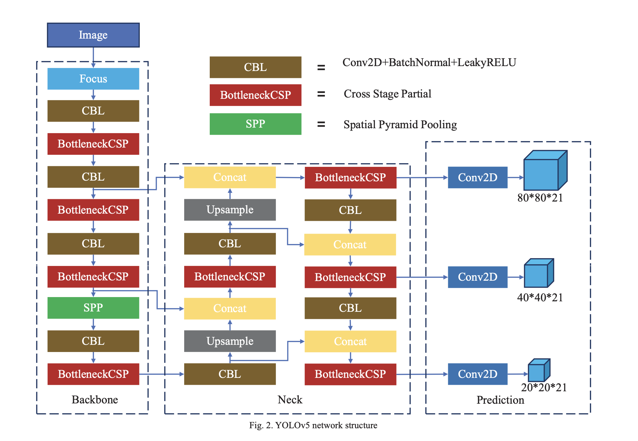
(b) YOLOv5

Slide 15
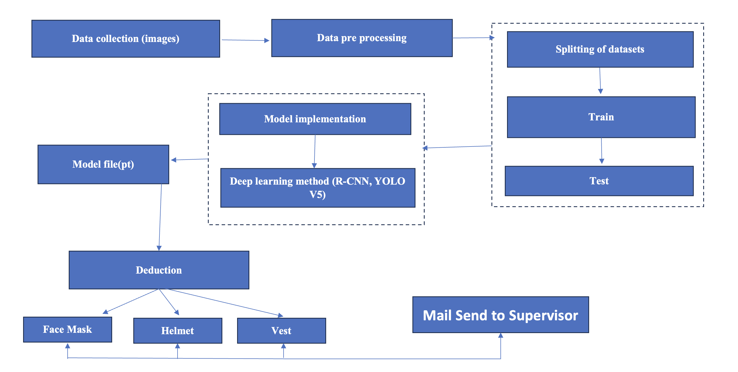
(b) Proposed Architecture

Slide 16
PROPOSED
SYSTEM:
Data collection
Data Pre processing
Model implementation
Loading the trained model
Deduction

Slide 17
Data collection
In this module, a comprehensive and diverse dataset is compiled, featuring individuals from various occupational settings wearing safety helmets, masks, and vests.
The dataset should be well-annotated and represent different lighting conditions, perspectives, and environmental contexts to ensure the robustness of the model.

Slide 18
Data Preprocessing
The collected dataset undergoes preprocessing to enhance its quality and suitability for training.
This involves tasks such as resizing images, normalizing pixel values, and applying data augmentation techniques to introduce variations.

Slide 19
Model Implementation
This module focuses on the actual implementation of the chosen deep learning model, whether it be YOLOv5.
The model architecture is configured, and training parameters are set. The code for the chosen algorithm is written or configured to adapt to the specific requirements of the safety gear detection task.

Slide 20
Loading the trained model
Once the model is trained successfully, it is saved and prepared for deployment.
This module involves creating a mechanism to load the trained model efficiently during the operational phase. The loading process ensures that the model is ready to make predictions on new data.

Slide 21
Prediction:
The final module involves utilizing the trained model to make predictions on live or new data captured by the webcam.
The webcam feed is continuously analyzed, and the model predicts the presence and correct usage of safety equipment in real-time.
This prediction module is crucial for the system to provide immediate feedback on safety compliance, contributing to the overall goal of enhancing safety measures in the monitored environment.

Slide 22
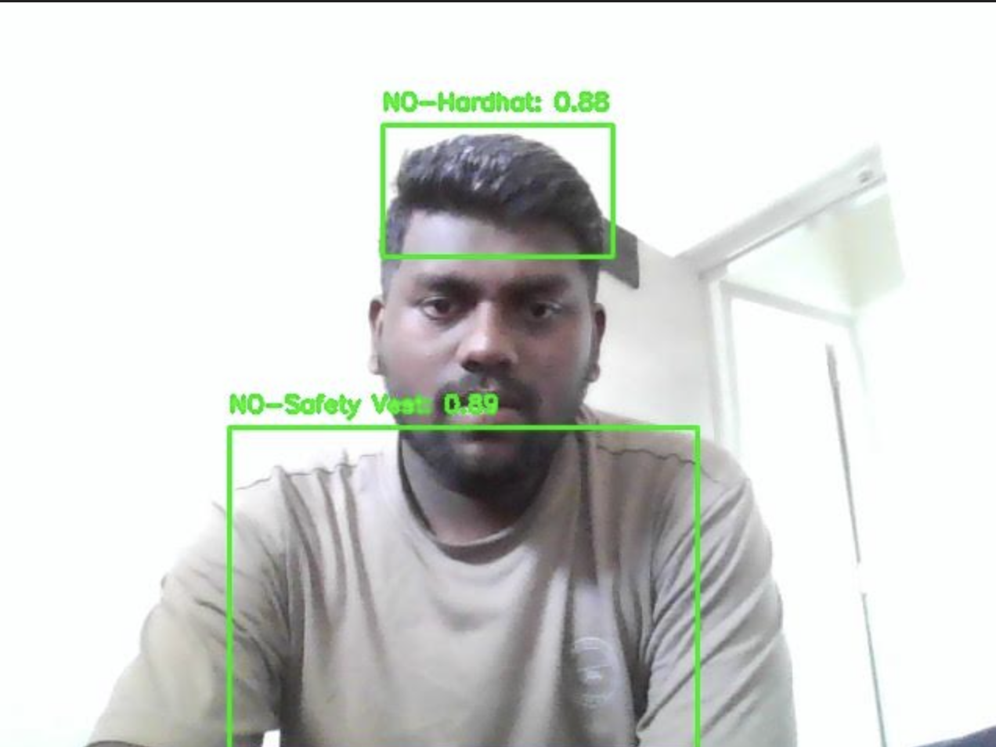
RESULTS:
As a result, the project is able to detect people those who are not wearing the safety outfit

Slide 23


Those who are not wearing the safety outfit, their Image, the safety outfit which they were not wearing with time will be mailed to the necessary person

Slide 24
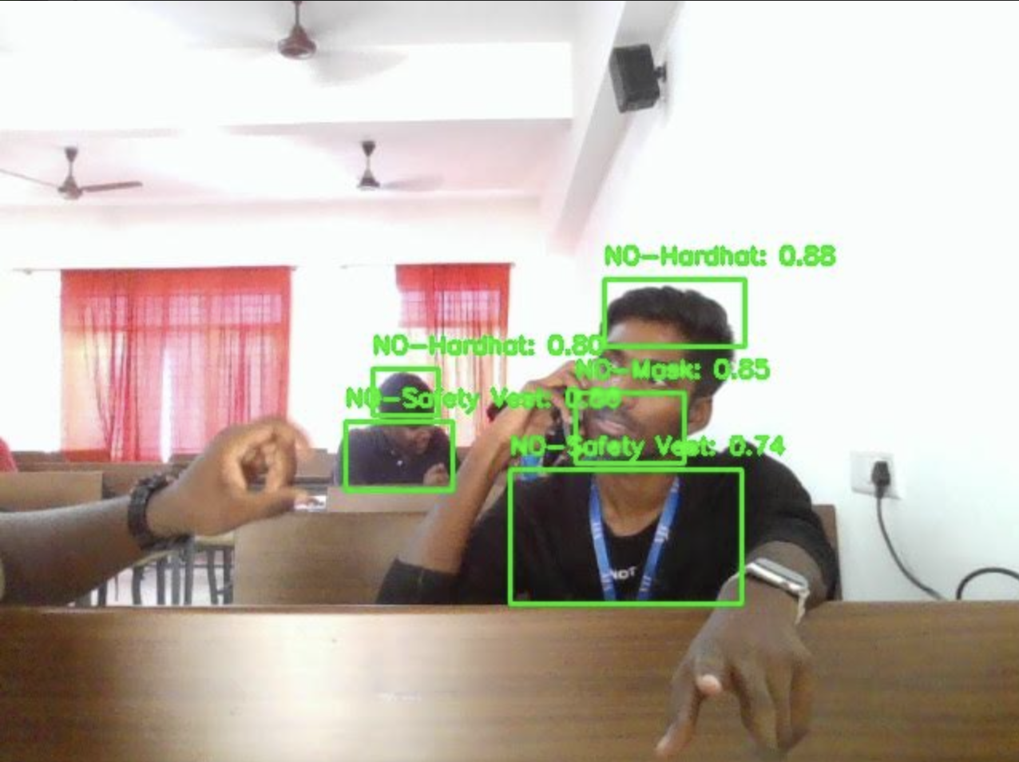
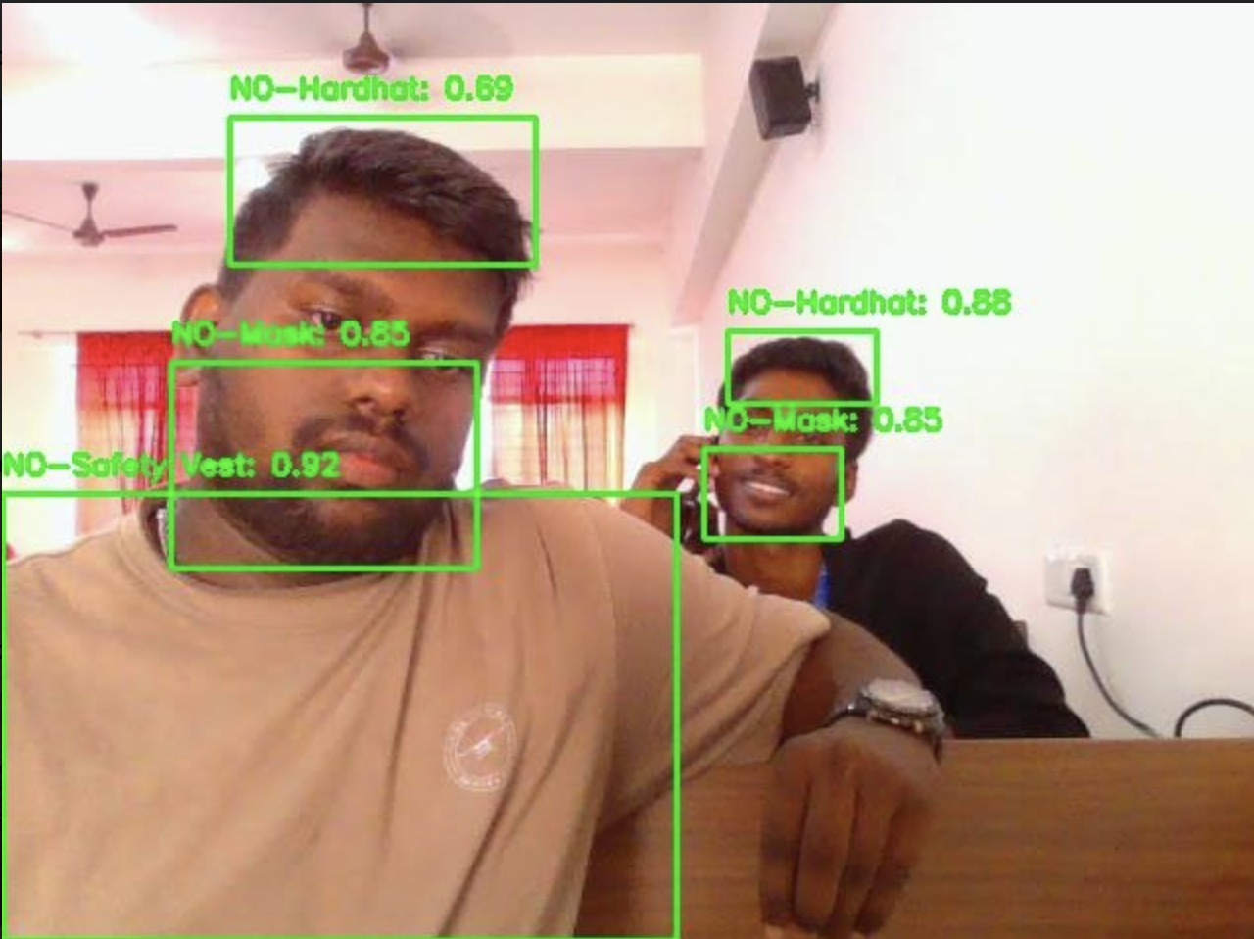

Slide 25
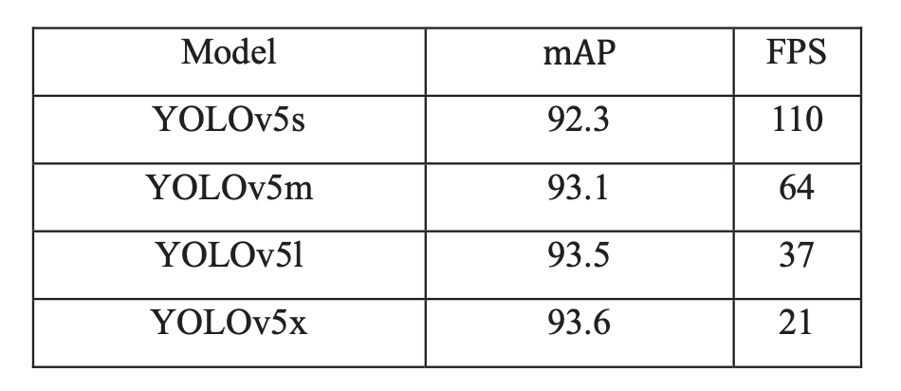
RESULT:

Slide 26
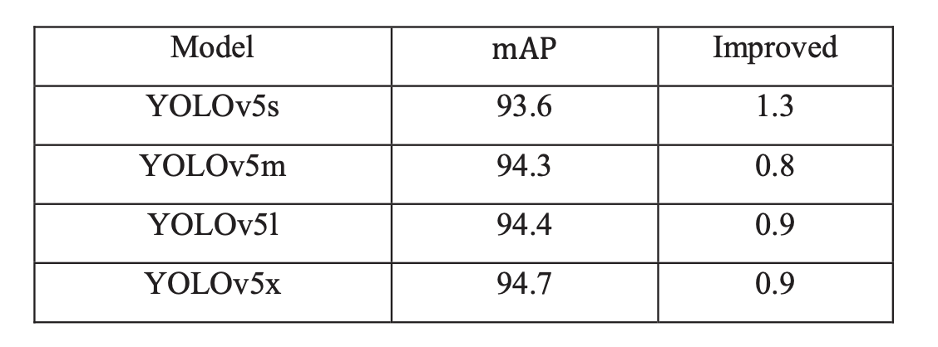
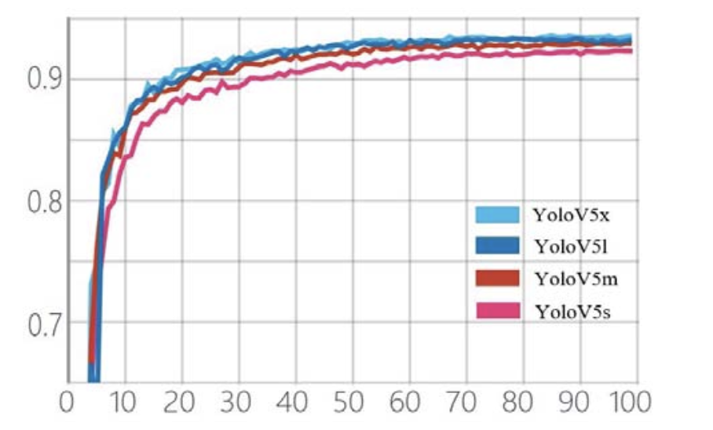
All four models show significant increases in mean Average Precision (mAP) during the first training phase. Of the models, YOLOv5x, which has the greatest parameters, shows the fastest improvement. The mAP values of the four models progressively converge over time.

Slide 27
CONCLUSION
In summary, this research delves into the realm of computer vision and deep learning, particularly focusing on the real-time detection of safety helmets, masks, and vests in industrial settings—an essential aspect for ensuring workplace safety. Through a comparative analysis of Faster YOLOv5, the study sheds light on their performance characteristics, considering metrics such as precision, detection accuracy, speed, and resource utilization. By evaluating these models across real-world scenarios and diverse datasets, the research attains practical relevance, making its findings applicable to the intricate and varied environments of industrial workplaces. Ultimately, by bridging theory with practical implementation, this study contributes significantly to the ongoing dialogue surrounding the utilization of deep learning techniques for enhancing workplace safety.

Slide 28
FUTURE WORK
Additionally, improvements in anomaly detection algorithms may make it possible to spot minute departures from safety procedures, strengthening preventative risk reduction tactics. Investigating cutting-edge architectures like graph neural networks and attention processes may provide more efficient means of capturing temporal and spatial relationships in safety monitoring activities. Furthermore, studies could concentrate on creating energy-efficient and lightweight models that can be deployed on edge devices to enable real-time safety monitoring in contexts with limited resources. To ensure consistency and dependability across various implementations, industry, academic institutions, and regulatory agencies could work together to develop standardized standards and processes for assessing safety gear detection systems. Ultimately, there is a great deal of promise for improving occupational safety procedures and creating safer work environments if advancements in the fields of computer vision and deep learning continue.

Slide 29
References
[1] X. Wang, D. Niu, P. Luo, C. Zhu, L. Ding and K. Huang, "A Safety Helmet and Protective Clothing Detection Method based on Improved-Yolo V 3," 2020 Chinese Automation Congress (CAC), Shanghai, China, 2020, pp. 5437-5441, doi: 10.1109/CAC51589.2020.9327187.
[2] Wang Z, Wu Y, Yang L, Thirunavukarasu A, Evison C, Zhao Y. Fast Personal Protective Equipment Detection for Real Construction Sites Using Deep Learning Approaches. Sensors. 2021; 21(10):3478. https://doi.org/10.3390/s21103478
[3] Xingxian Bao, Tongxuan Fan, Chen Shi, Guanlan Yang, Deep learning methods for damage detection of jacket-type offshore platforms,Process Safety and Environmental Protection,Volume 154,2021,
[4] Nath, N. D., & Behzadan, A. H. (2020, March). Deep learning detection of personal protective equipment to maintain safety compliance on construction sites. In Construction Research Congress 2020 (pp. 181-190). Reston, VA: American Society of Civil Engineers.
[5] Nath, N. D., Behzadan, A. H., & Paal, S. G. (2020). Deep learning for site safety: Real-time detection of personal protective equipment. Automation in Construction, 112, 103085.
[6] Wang, Z., Wu, Y., Yang, L., Thirunavukarasu, A., Evison, C., & Zhao, Y. (2021). Fast personal protective equipment detection for real construction sites using deep learning approaches. Sensors, 21(10), 3478.
[7] Vukicevic, A. M., Djapan, M., Isailovic, V., Milasinovic, D., Savkovic, M., & Milosevic, P. (2022). Generic compliance of industrial PPE by using deep learning techniques. Safety science, 148, 105646.

Slide 30
References
[8] Ahmed, M. I. B., Saraireh, L., Rahman, A., Al-Qarawi, S., Mhran, A., Al-Jalaoud, J., ... & Gollapalli, M. (2023). Personal protective equipment detection: A deep-learning-based sustainable approach. Sustainability, 15(18), 13990.
[9] Long, X., Cui, W., & Zheng, Z. (2019, March). Safety helmet wearing detection based on deep learning. In 2019 IEEE 3rd information technology, networking, electronic and automation control conference (ITNEC) (pp. 2495-2499). IEEE.
[10] Cheng, J. P., Wong, P. K. Y., Luo, H., Wang, M., & Leung, P. H. (2022). Vision-based monitoring of site safety compliance based on worker re-identification and personal protective equipment classification. Automation in Construction, 139, 104312.
[11] Wang, S., Li, X., Chen, W., Fan, W., & Tian, Z. (2022). An intelligent vision-based method of worker identification for industrial internet of things (IoT). Wireless Communications and Mobile Computing, 2022.
[12] Ahn, J., Park, J., Lee, S. S., Lee, K. H., Do, H., & Ko, J. (2023). SafeFac: Video-based smart safety monitoring for preventing industrial work accidents. Expert Systems with Applications, 215, 119397.
[13] Li, J., Zhao, X., Zhou, G., & Zhang, M. (2022). Standardized use inspection of workers' personal protective equipment based on deep learning. Safety science, 150, 105689.
[14] Nain, M., Sharma, S., & Chaurasia, S. (2021, March). Safety and compliance management system using computer vision and deep learning. In IOP Conference Series: Materials Science and Engineering (Vol. 1099, No. 1, p. 012013). IOP Publishing.
[15] Hayat, A., & Morgado-Dias, F. (2022). Deep learning-based automatic safety helmet detection system for construction safety. Applied Sciences, 12(16), 8268.
[16] Nath, N. D., Behzadan, A. H., & Paal, S. G. (2020). Deep learning for site safety: Real-time detection of personal protective equipment. Automation in Construction, 112, 103085.

Slide 31
References
[17] Li, G., Yang, Y., & Qu, X. (2019). Deep learning approaches on pedestrian detection in hazy weather. IEEE Transactions on Industrial Electronics, 67(10), 8889-8899.
[18] Ling, X., Ji, S., Zou, J., Wang, J., Wu, C., Li, B., & Wang, T. (2019, May). Deepsec: A uniform platform for security analysis of deep learning model. In 2019 IEEE Symposium on Security and Privacy (SP) (pp. 673-690). IEEE.
[19] Antwi-Afari, M. F., Qarout, Y., Herzallah, R., Anwer, S., Umer, W., Zhang, Y., & Manu, P. (2022). Deep learning-based networks for automated recognition and classification of awkward working postures in construction using wearable insole sensor data. Automation in construction, 136, 104181.
[20] Rebekah, J., Wise, D. J. W., Bhavani, D., Regina, P. A., & Muthukumaran, N. (2020, July). Dress code Surveillance Using Deep learning. In 2020 International Conference on Electronics and Sustainable Communication Systems (ICESC) (pp. 394-397). IEEE.
[21] Lee, M., & Bae, J. (2020). Deep learning based real-time recognition of dynamic finger gestures using a data glove. IEEE Access, 8, 219923-219933.
[22] Rosero-Montalvo, P. D., Godoy-Trujillo, P., Flores-Bosmediano, E., Carrascal-García, J., Otero-Potosi, S., Benitez-Pereira, H., & Peluffo-Ordonez, D. H. (2018, October). Sign language recognition based on intelligent glove using machine learning techniques. In 2018 IEEE Third Ecuador Technical Chapters Meeting (ETCM) (pp. 1-5). IEEE.
[23] Seong, H., Son, H., & Kim, C. (2018). A comparative study of machine learning classification for color-based safety vest detection on construction-site images. KSCE Journal of Civil Engineering, 22, 4254-4262.
[24] Chen, Z., Zhang, F., Liu, H., Wang, L., Zhang, Q., & Guo, L. (2023). Real-time detection algorithm of helmet and reflective vest based on improved YOLOv5. Journal of Real-Time Image Processing, 20(1), 4.
[25] Chen, Z., Zhang, F., Liu, H., Wang, L., Zhang, Q., & Guo, L. (2023). Real-time detection algorithm of helmet and reflective vest based on improved YOLOv5. Journal of Real-Time Image Processing, 20(1), 4.

